Slide 1

Scaling distributed systems reliably
Natalia Chechina
NChechina@bournemouth.ac.uk
@nchechina
28 october 2019
Notes:
50min with questions

Slide 2



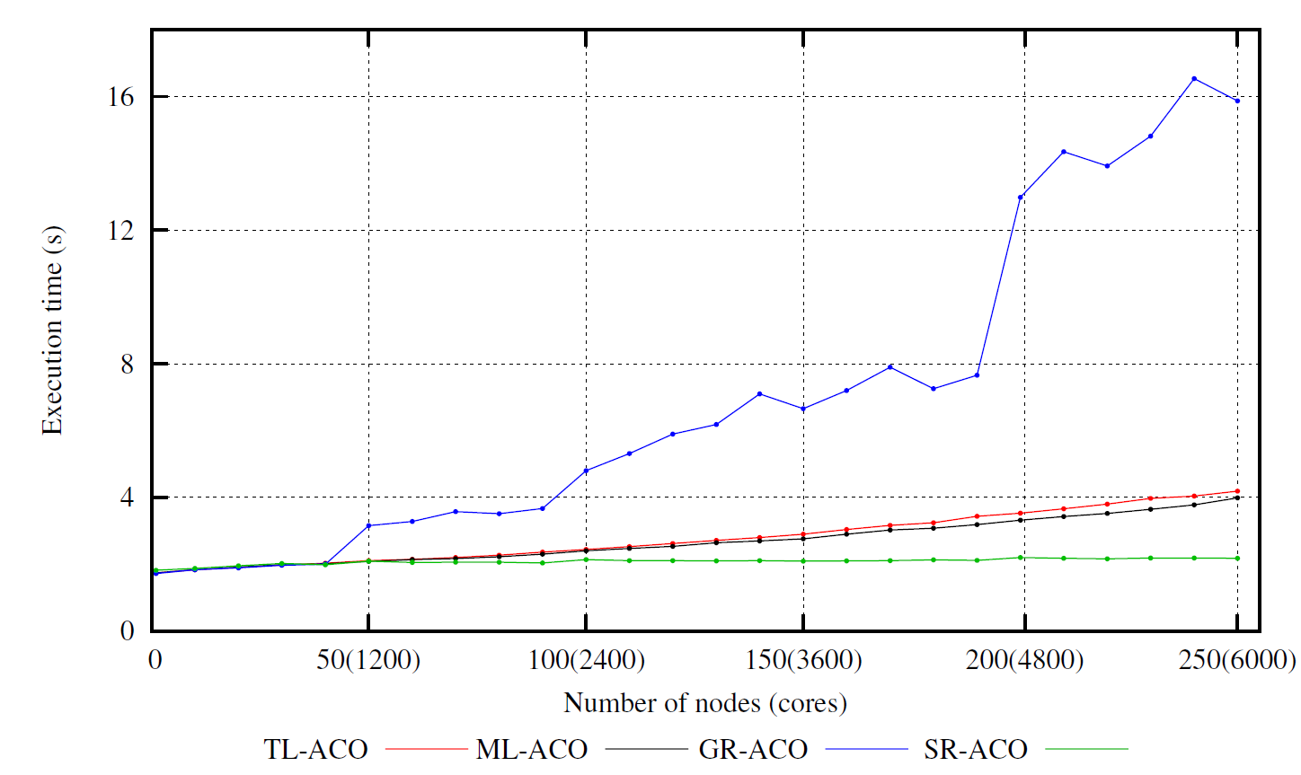



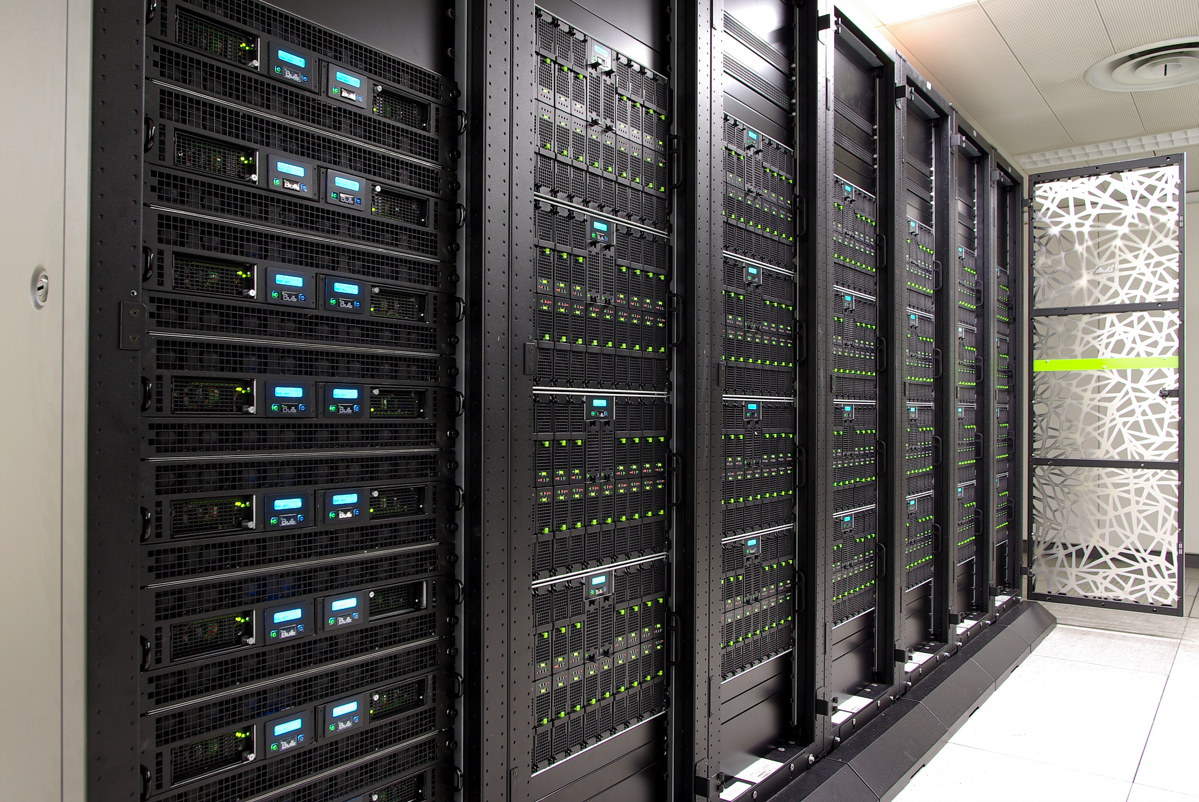




Scaling the Erlang Programming Model
A High-Level Paradigm for Reliable
Large-Scale Server Software
N. Chechina, K. MacKenzie, S. Thompson, P. Trinder, O. Boudeville, V. Fordos, C. Hoch, A. Ghaffari, M. Moro Hernandez. Evaluating Scalable Distributed Erlang for Scalability and Reliability. IEEE Transactions on Parallel and Distributed Systems (TPDS), DOI: 10.1109/TPDS.2017.2654246, January 2017.

Slide 3

Distributed Actor Language
Developed at Ericsson in 1986
Functional
General purpose
Concurrent
Dynamically typed
Designed for
Distributed
Fault-tolerant
Massively concurrent
Soft-real time systems

Slide 4
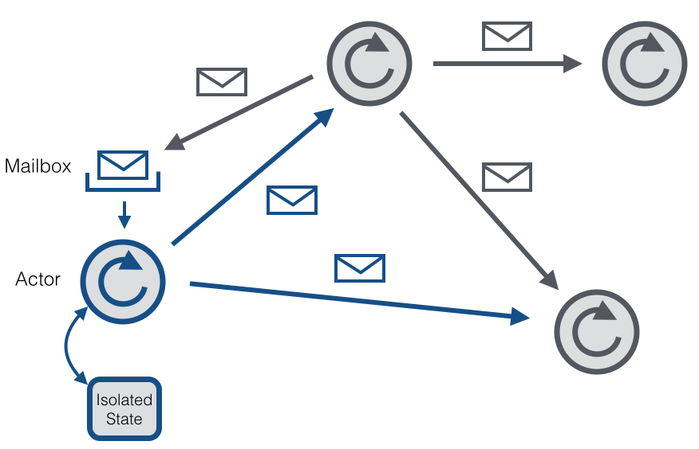
erlang
Follows Let it crash and Share nothing philosophies
“Erlang concurrency is handled by the language and not by the operating system.”
Joe Armstrong

Slide 5
Scalability & Reliability in Erlang
Share nothing
Private process state
Stateful interactions via message passing
Let it crash
Non-defensive programming
Supervision trees
Lightweight processes
Registered names

Slide 6




















Typical erlang applications
Telecoms (Ericsson, Motorola, T-Mobile)
Instant Messengers (WhatsApp, Facebook Messenger (?))
NoSQL Distributed DataBases (Amazon SimpleDB, Riak, CouchDB)
Games (Call of Duty, League of Legends)
Payment services (Klarna)
Social bookmarking (Yahoo! Delicious)

Slide 7
Scaling the Erlang Programming Model
A High-Level Paradigm for Reliable
Large-Scale Server Software
N. Chechina, K. MacKenzie, S. Thompson, P. Trinder, O. Boudeville, V. Fordos, C. Hoch, A. Ghaffari, M. Moro Hernandez. Evaluating Scalable Distributed Erlang for Scalability and Reliability. IEEE Transactions on Parallel and Distributed Systems (TPDS), DOI: 10.1109/TPDS.2017.2654246, January 2017.

Slide 8
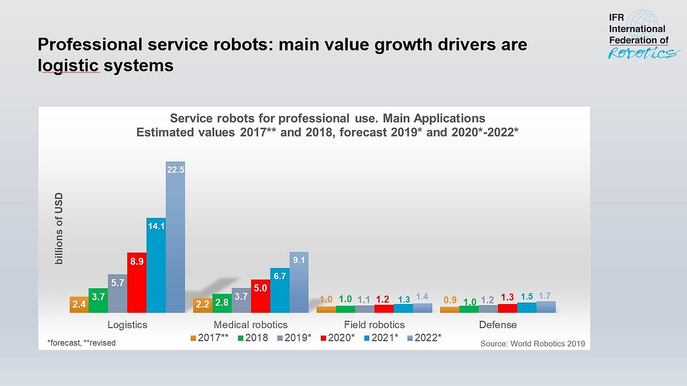
relevance
Active IoT devices
2019 – 26.66Bn
By 2025 – 75 Bn

Slide 9

Rationale
Smart cities and campuses
Robots
Assistants -- hospitals, agriculture, farms
Explorers -- Mars, forest, underwater
UAVs (Unmanned Autonomous Vehicles)
Autonomous cars
Notes:
The reason I believe it’s a very important question that we need to consider now is that
By 2020 we are expected to have between 20 and 50 billion of internet of things devices

Slide 10


Robot
How intelligent and autonomous does a machine have to be to qualify as a robot?
Is washing machine a robot?

Slide 11
Robot
How intelligent and autonomous does a machine have to be to qualify as a robot?
Is washing machine a robot?
can sense and act.
must process information (think) to connect sensing and action

Slide 12
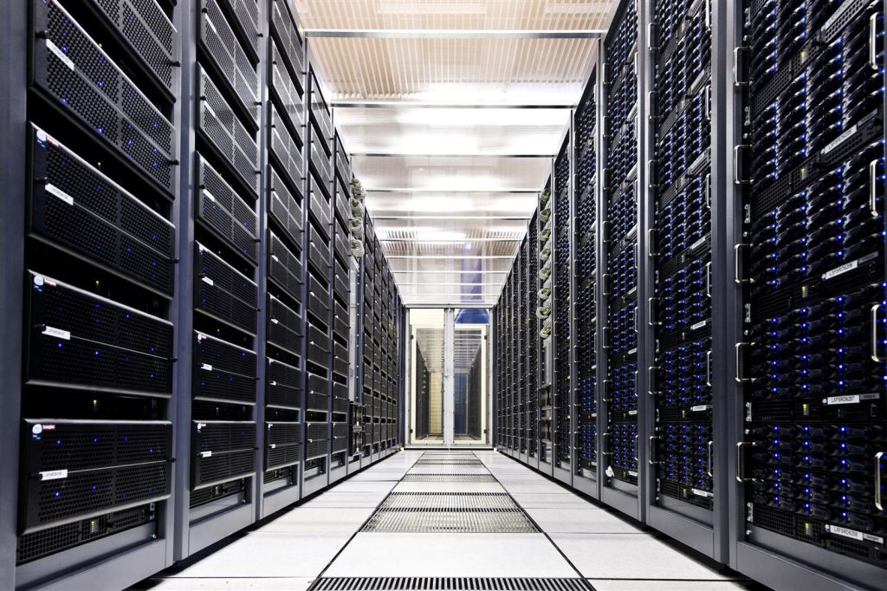
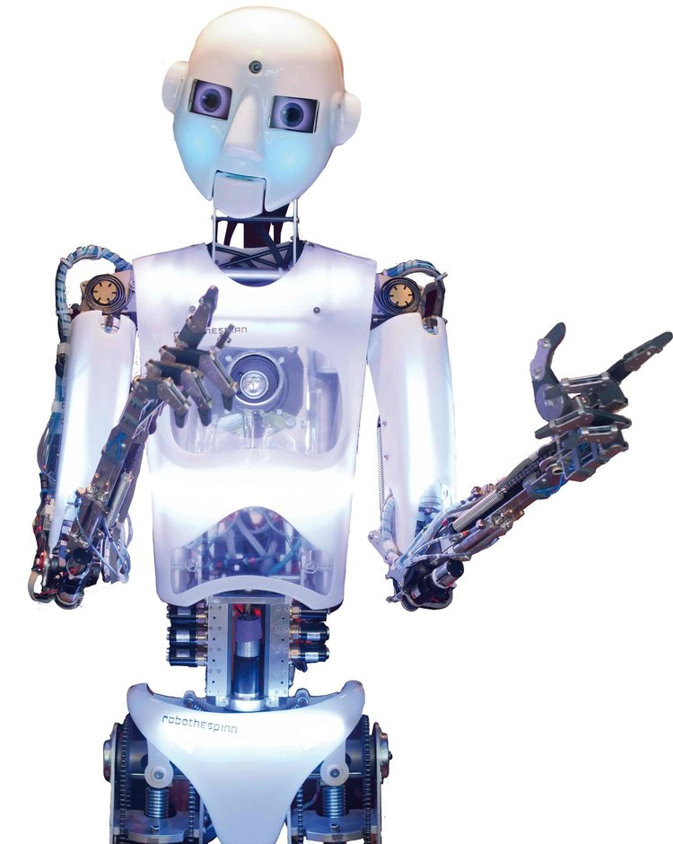
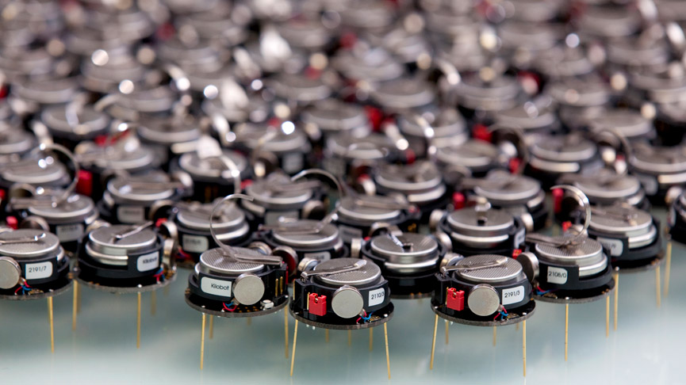
We are not dealing with…
“Classical” distributed systems,
but rather autonomous devices
Slower and less stable communication
Very different types of devices
E.g. limited computation & power resources, each device is a network, are threat and at risk at the same time
Swarm robotics
Simple physical robots with emergent behaviour
but rather a pack of autonomous devices
Complex devices capable of various tasks, contribute to a common goal

Slide 13
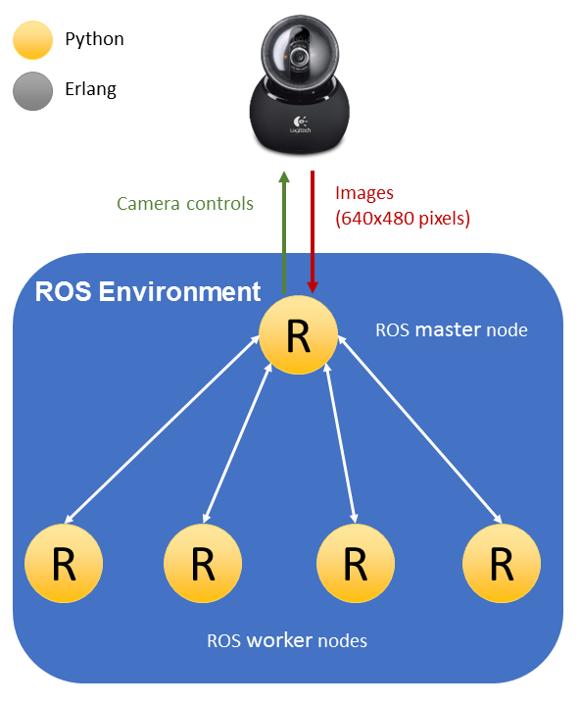
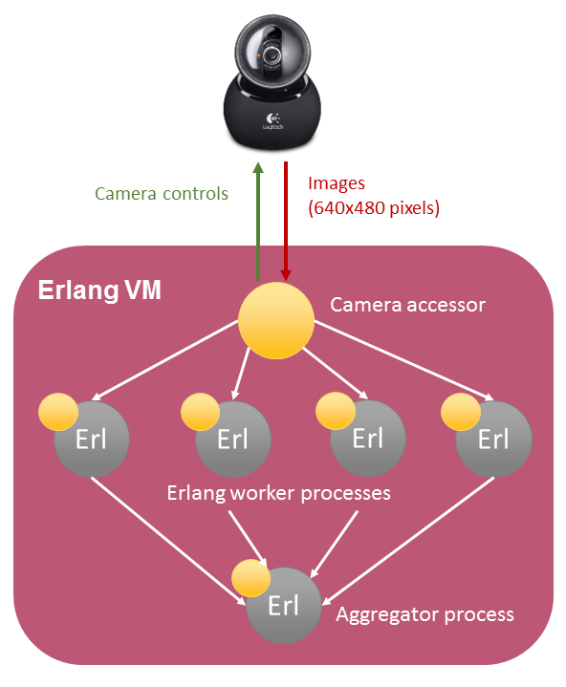

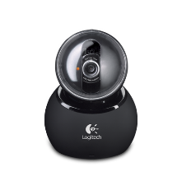
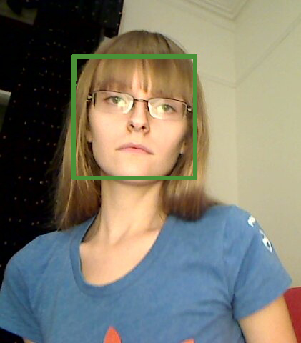
Preliminary results
The most widely used Robot Operating System
vs.
“Let it crash” using Erlang programming language

Slide 14

Robot Operating System
Since 2007 simplifies the creation of complex robot behaviour across a wide variety of robotic platforms
A de facto standard collection of
Tools
Libraries
Conventions
NO SINGLE INDIVIDUAL, LABORATORY, OR INSTITUTION CAN HOPE TO DO IT ON THEIR OWN

Slide 15

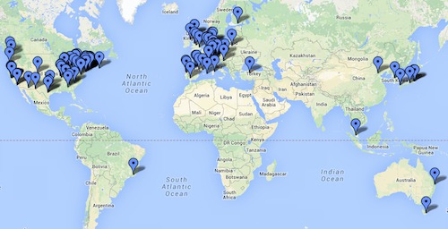
purpose
Access to
Hardware drivers
Generic robot capabilities
Development tools
External libraries
etc...
Systems may use as much or as little of ROS
Encourage collaborative development of robotics software

Slide 16
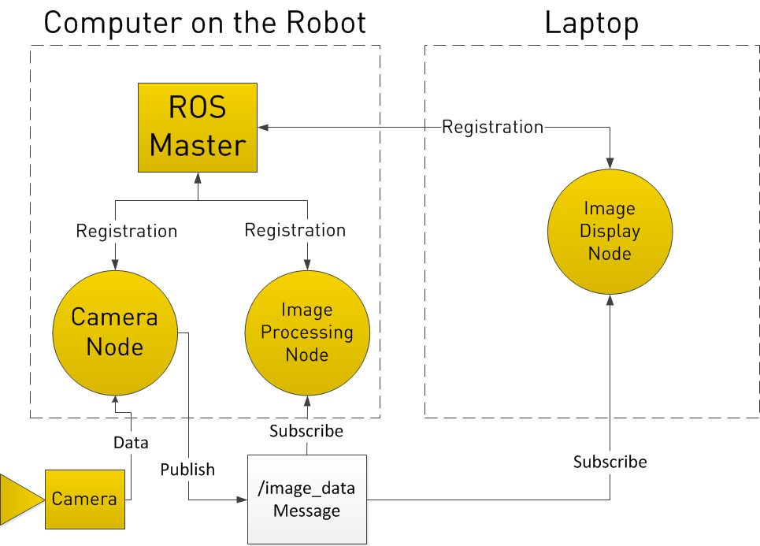
OVERVIEW
Distributed Modular Design
Open source
Shared development of common components
Publish/subscribe message passing
Master node
Registration of all nodes
Single point of failure

Slide 17
Preliminary results
The most widely used Robot Operating System
vs.
“Let it crash” using Erlang programming language

Slide 18
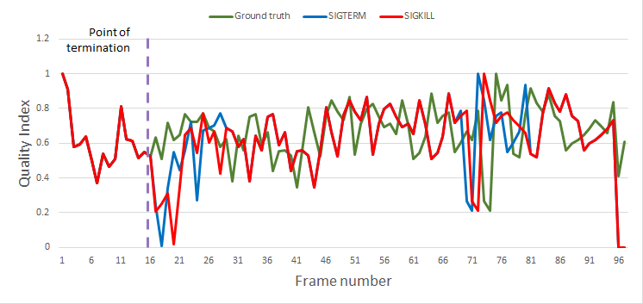
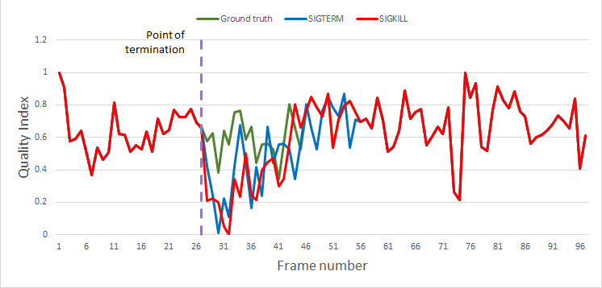

Quality Variations with Worker Failures
10%
50%
Reduces robot component downtime
Mitigates negative impact of failures
A. Lutac, N. Chechina, G. Aragon Camarasa, and P. Trinder. Towards Reliable and Scalable Robot Communication. In the Proceedings of the 15th ACM SIGPLAN Workshop on Erlang, pp. 12--23, Nara, Japan, 2016

Slide 19
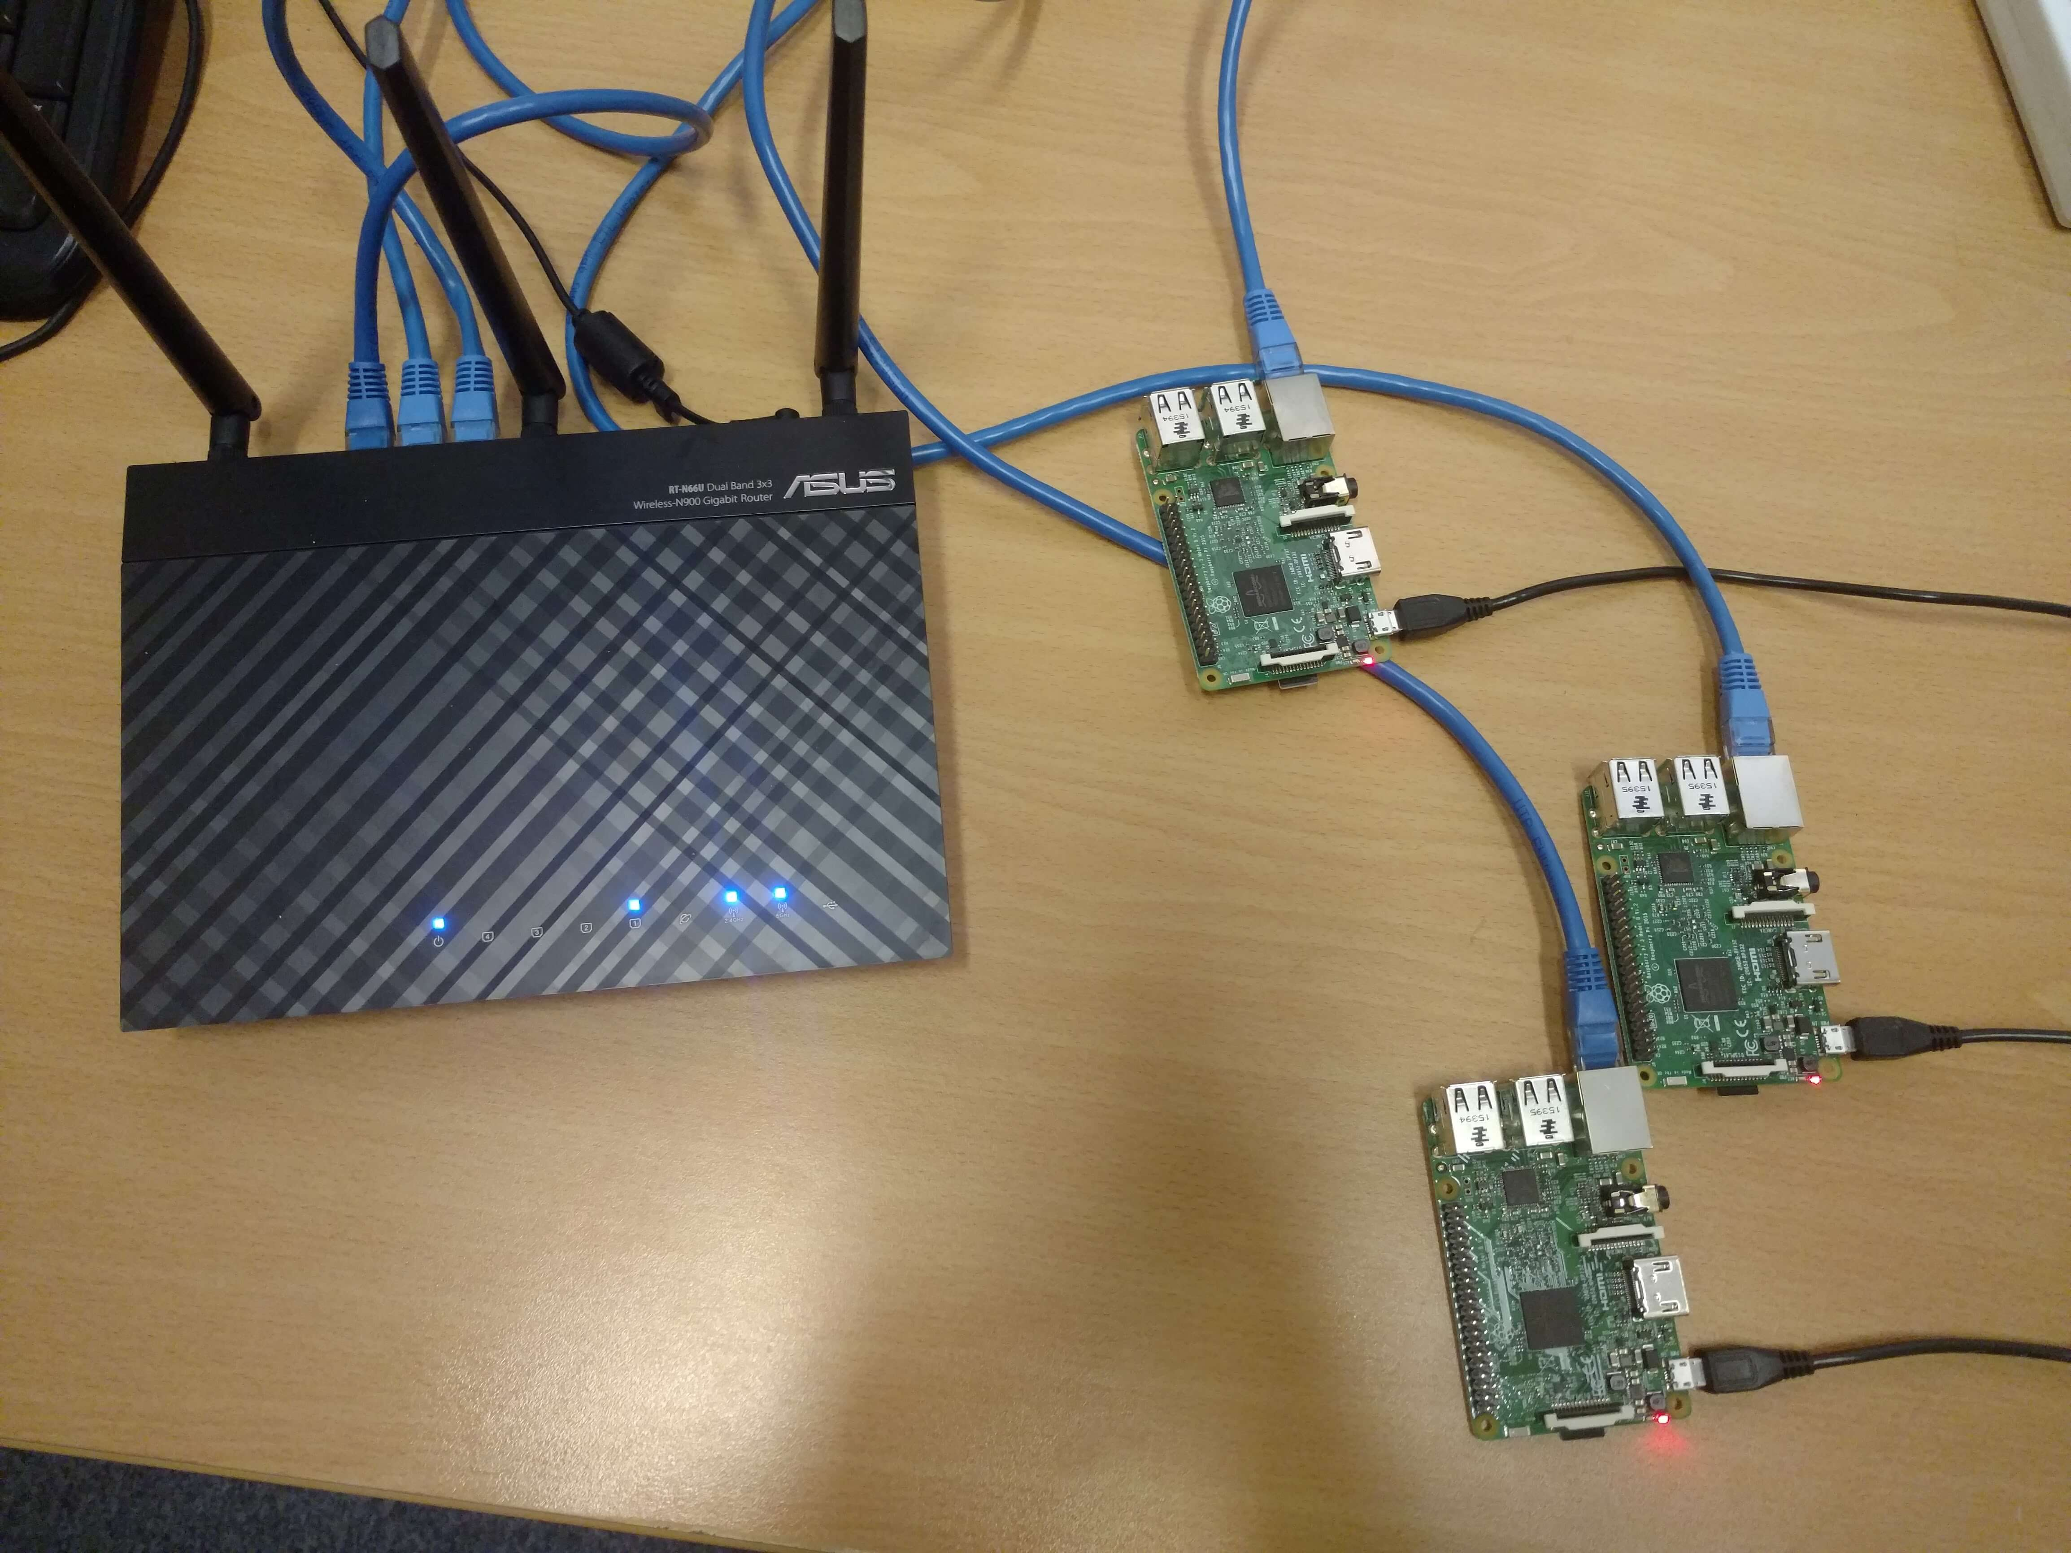
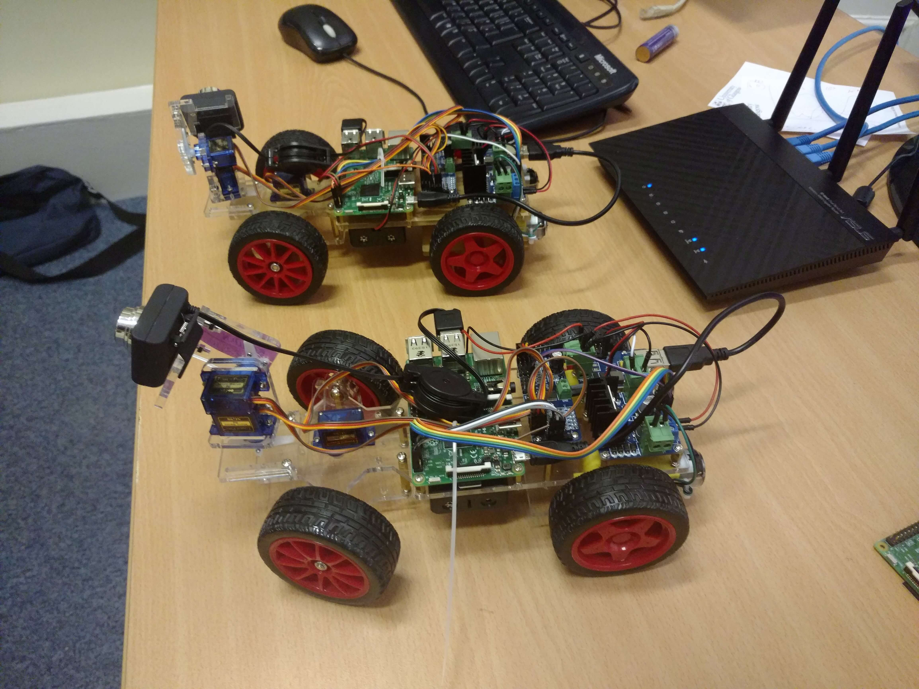
vertical scalability

Slide 20
vertical scalability
Representative data
Wi-Fi connection
Hosts
Raspberry Pis
Car kit robots

Slide 21
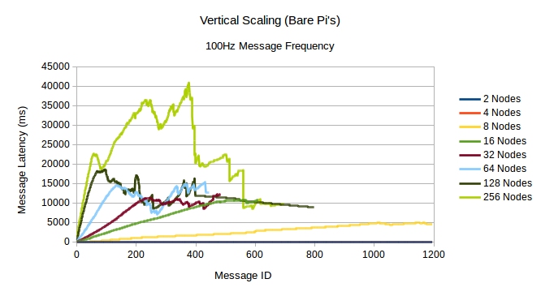
Multiple hosts: vertical scalability

Slide 22

SCLV -- Communication Scaling Limit Volume
N -- number of sending nodes on the host
f_{m} -- message frequency
S_{m} -- message size
$$\text{CSLV}\text{ = }\text{N}∙f_{m}∙S_{m}$$

Slide 23
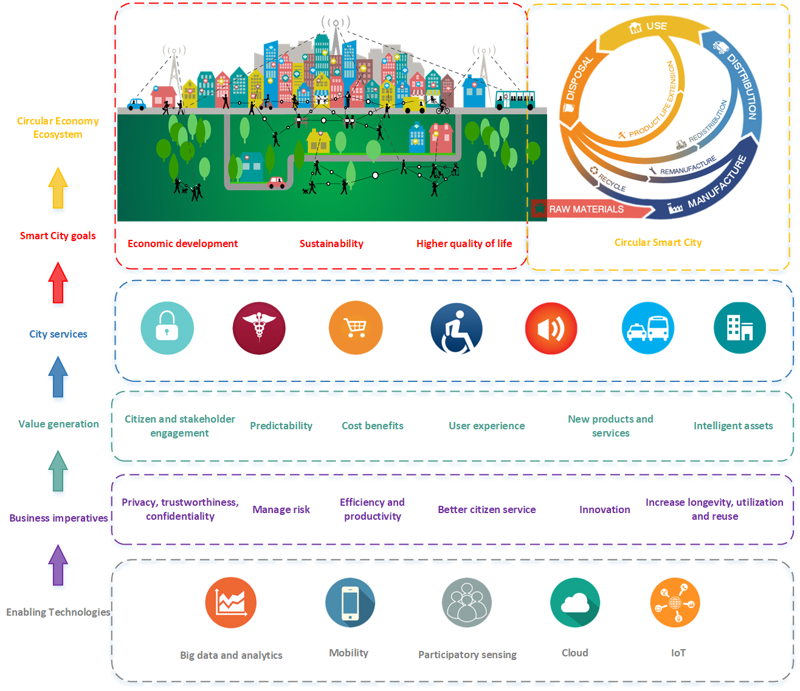


Slide 24
Thank you!
nchechina@bournemouth.ac.uk
@nchechina
https://staffprofiles.bournemouth.ac.uk/display/nchechina

